Slide 1

Elasticsearch
Mustapha Friha / Zijun Mei / Charlie Botdorf
UNO CYBR-8420 Fall 2022 class

Slide 2
Elasticsearch
Elasticsearch is a distributed, scalable, RESTful search and analytics engine built on top of the Apache Lucene library
Elasticsearch is developed in Java
An active open-source software with close of two thousand contributors
Elasticsearch can be hosted On Premise or in the Cloud
It is supported on many popular operating systems such as Linux, MacOS, or Windows
Used by big companies like Microsoft, Cisco, Walmart, Adobe, Pfizer, CenturyLink, Facebook, and others
It is commonly used for log analytics, full-text search and security intelligence (security threat detection)

Slide 3
Elasticsearch stores data as JSON documents
Elasticsearch search is fast. Really, really fast
Inverted indices implemented to allow fast and full text searches in a large volumes of data
Data nodes store the data in small storage partitions called shards
Each shard works as an independent Lucene index
Easily ingest data from different sources such as logs, metrics, traces and events
Using different integration solutions like Elastic Agent, Logstash, Filebeat or custom REST client

Slide 4
Elasticsearch is scalable
Elasticsearch cluster is composed of a collection of connected nodes
Cluster can have hundreds of nodes
Data is distributed across all the nodes
Elasticsearch is resilient
Resilient cluster with nodes redundancy in case of failure (Replica shards)
Secondary clusters with cross-cluster replication as backup clusters in case of disaster recovery
Elasticsearch monitoring to prevent, detect and alert about the cluster health
Elasticsearch Kibana dashboards

Slide 5
Elasticsearch has a rich set of security features
User Authentication - It can integrate with several industry standard IAM systems such as Active Directory, LDAP, SSO Kerberos and SAML
Authorization – Uses role-based access control (RBAC) mechanism
Encryption – Uses TLS encryption to secure client traffic and node-to-node communication
Layered security - Secure all the way down to the field level
Security from top to bottom: Cluster, Index, Document and Field
Audit logging
Compliance – FIPS-140, HIPAA, PCI
Short Elasticsearch marketing demo video https://youtu.be/wzPMtmINEhU

Slide 6
Our Hypothetical Operational Environment is a hospital
Patients' medical records are stored in Elasticsearch cluster
PII/PHI data needs to be protected under HIPAA rules
Perceived threats
Malicious patient data breach from Elasticsearch cluster
Unauthorized access to patient PII/PHI data from health care personnel
Elasticsearch resiliency issues to hardware and network failures
Data loss/corruption due to system failure, disaster, or intentional/unintentional human errors
Malformed/Arbitrary search queries to Elasticsearch may reveal sensitive information

Slide 7
Assurance claims
Claim #1: Elasticsearch acceptably minimizes the risk of unauthorized access
Our research supports this claim based on the following arguments:
Users are required to authenticate in Elasticsearch before accessing any documents
TLS encryption data communication to prevent man-in-the-middle attack
Access monitoring through Elastic Kibana to visualize data access and to block any unauthorized IP addresses (IP filtering)
Role-based access control (RBAC) mechanism
Code review didn't reveal any issues related to authentication or data access modules

Slide 8
Assurance claims
Claim #2: Stored data is acceptably protected from unauthorized changes
Our research also supports this claim based for the arguments presented with claims #1. In addition, we have the following:
All CRUD operations must send the HTTP Authorization header with every Elasticsearch Rest API request
Elasticsearch provides security features to sanitize the data (redact sensitive information) before storing it
Query results can also be sanitized to not return malicious data to prevent against Cross-Site Scripting (XSS) attacks

Slide 9
Assurance claims
Claim #3: Patient data is available in timely manner
We support this claim too for the many resiliency and high availability features available in Elasticsearch
Data indexed and distributed across multi nodes to allow fast searches
Security features to control query runtime by setting timeout and max query results set
Circuit breaker to prevent operations which can cause JVM heap memory exceed a certain threshold
Redundancy/Data replication in data nodes
Secondary clusters set up to distribute data load or for disaster recovery
No issues found during both manual and automated code review

Slide 10

Gaps In Security Requirements And Design
Elasticsearch itself does not provide 2FA authentication
Password policy is unavailable in Elasticsearch
Account lockout protection functionality is unavailable in Elasticsearch.
Authentication mechanism for cross-cluster data requests is unavailable.
Notes:
Thank you, mustapha.
And hello everyone, I am Zijun Mei.
Now, let me introduce you what are the gaps that we found in Security Requirements And Design of Elasticsearch.
Basically, we found 4 gaps based on misuse case and data flow diagrams.
The first three articles are all about gaps in user authentication.
The first one is : Elasticsearch itself does not provide 2FA authentication.
The second one is Password policy is unavailable in Elasticsearch.
The third one is Account lockout protection functionality is unavailable in Elasticsearch.
the reasons for three gaps are all have the same,
the developer of Elasticsearch indicates that they encourage users needing more sophisticated setups to adopt an external authentication provider such as SAML or OIDC. Therefore, Elasticsearch itself does not provide 2FA authentication, password policy, and lockout protection, but it supports an external authentication provider to do it.
The fourth gaps is Authentication mechanism for cross-cluster data requests is unavailable. According to our threat model report, one of the primary sources of threats is the inability to verify the authenticity of the data flow source. We have yet to find evidence that the Elasticsearch provide Authentication mechanism for cross-cluster data requests.
An ideal solution uses “the host-based authentication mechanism (HBA)” or “the enhanced host-based authentication mechanism (HBA2)”. The main principle of these two mechanisms is to create a unique private/public key pair for each node in the cluster. Only the node with the corresponding key pair can be considered trustworthy.
In next section, Charlie will introduce you our code review results, key finding, and contributions.

Slide 11
Automated Scan
Used Fortify On Demand for automated scan
Scanned Elasticsearch X-Pack folder
Total of 8607 files
Majority of critical issues found are from Test folder
Complemented with secondary scan using CodeQL
Scanning tool provided by Github

Slide 12
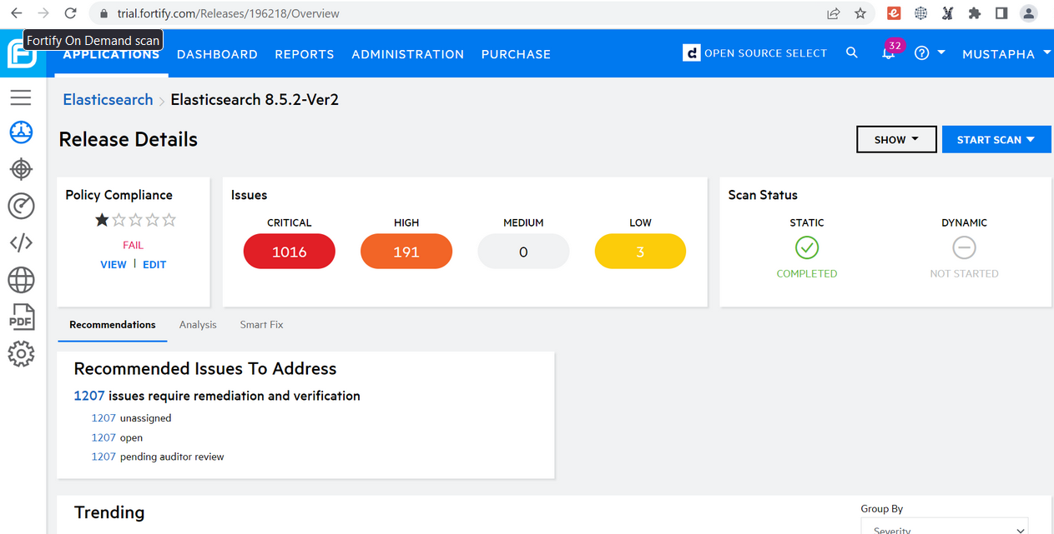
Fortify Scan Results

Slide 13
Key Findings
CWE-20: Improper Input Validation
Manually reviewed this because it was relevant to threats found in Authentication Threat Model
The actual range of characters defined by the programmer may be larger than the range he intended to define.
CWE-327: Use of a Broken or Risky Cryptographic Algorithm
Insecure Transport: Weak SSL Protocol - use of weak or outdated SSL or TLS versions when a client is connecting to a web server, found in CommandLineHttpClient.java line 153
Weak Encryption - CryptUtils.java uses a weak encryption algorithm
Weak Encryption: Insecure Mode of Operation - CryptUtils.java, encryption algorithm used uses an insecure mode of operation
After deep manual code review for this CWE, we determined that the java class reported is not used in Elasticsearch operational mode. Nevertheless, we will report it as findings from Elasticsearch for the confusion.

Slide 14
Key Findings
CWE-476: NULL Pointer Dereference
A null pointer dereference occurs when a pointer what is assumed to be valid, but is null, is dereferenced in the codebase.
There are 34 instances identified by Fortify
CWE-918: Server-Side Request Forgery (SSRF)
Manually reviewed because it is a critical alert in the CodeQL results
Line 277 of the class JwtUtil.java, the programmer does not set a verify mechanism for validation of the URL, which is provided by user

Slide 15
Contribution
Elasticsearch does not allow pull requests in Github for security issues
Security policy requests that security issues be reported to:
HackerOne bug bounty program
security@elastic.co
Issues to report:
Outdated versions of SSL and TLS
34 instances of NULL pointer dereferences

